Slide 1
INV-ES-FF-ET-TAH21
INSTALL INSTRUCTIONS

Slide 2
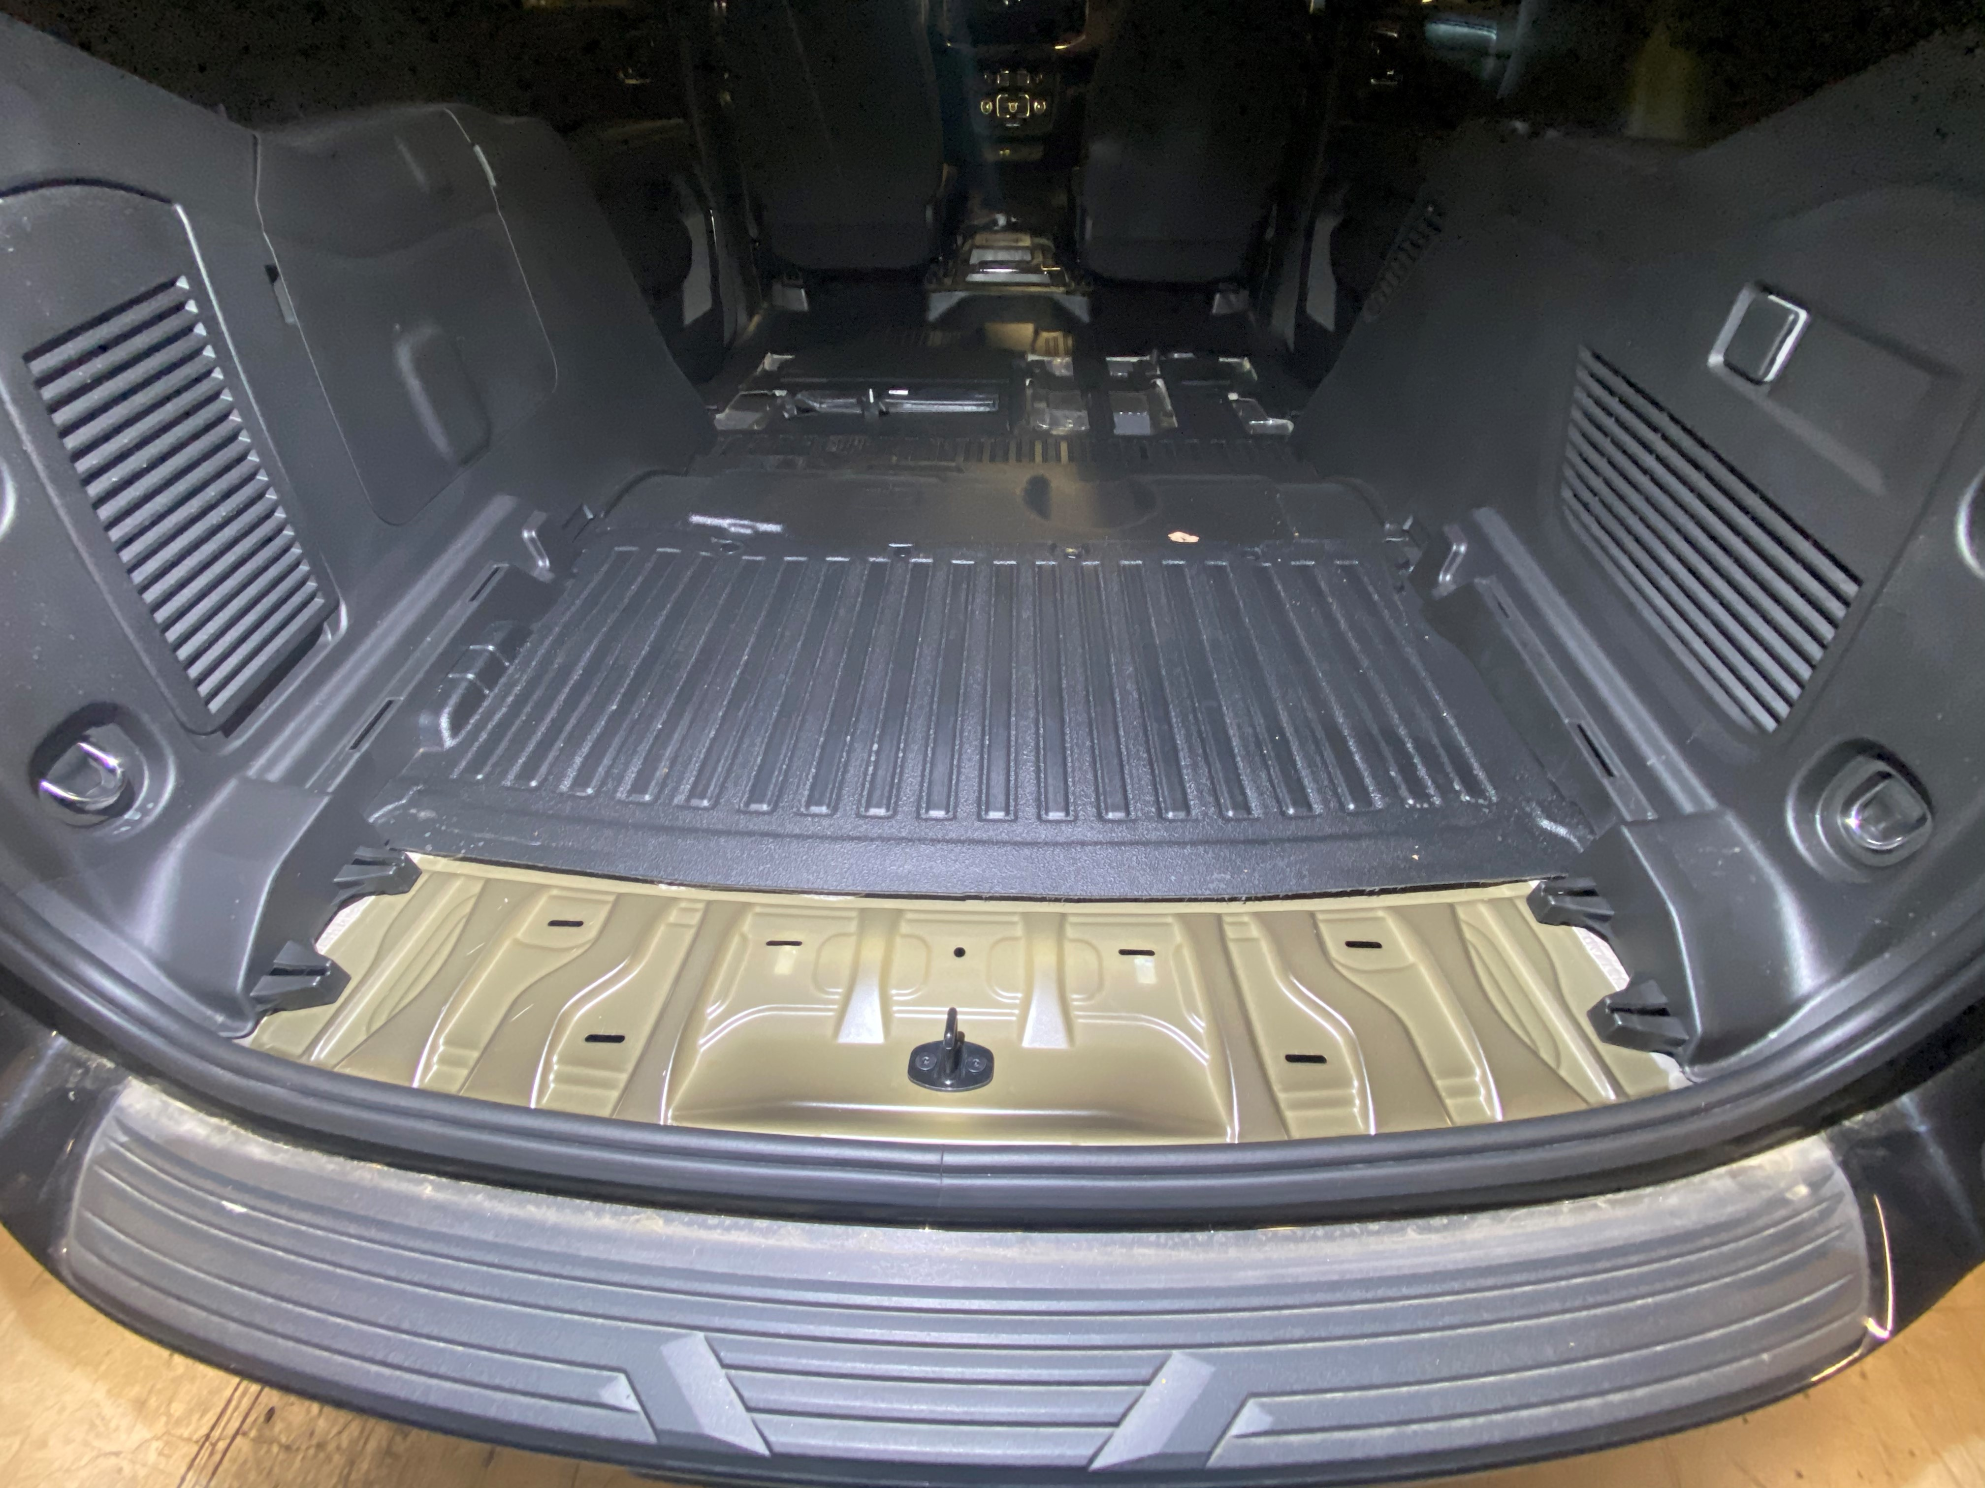
REMOVE LOWER TRIM IN REAR OF VEHICLE

Slide 3
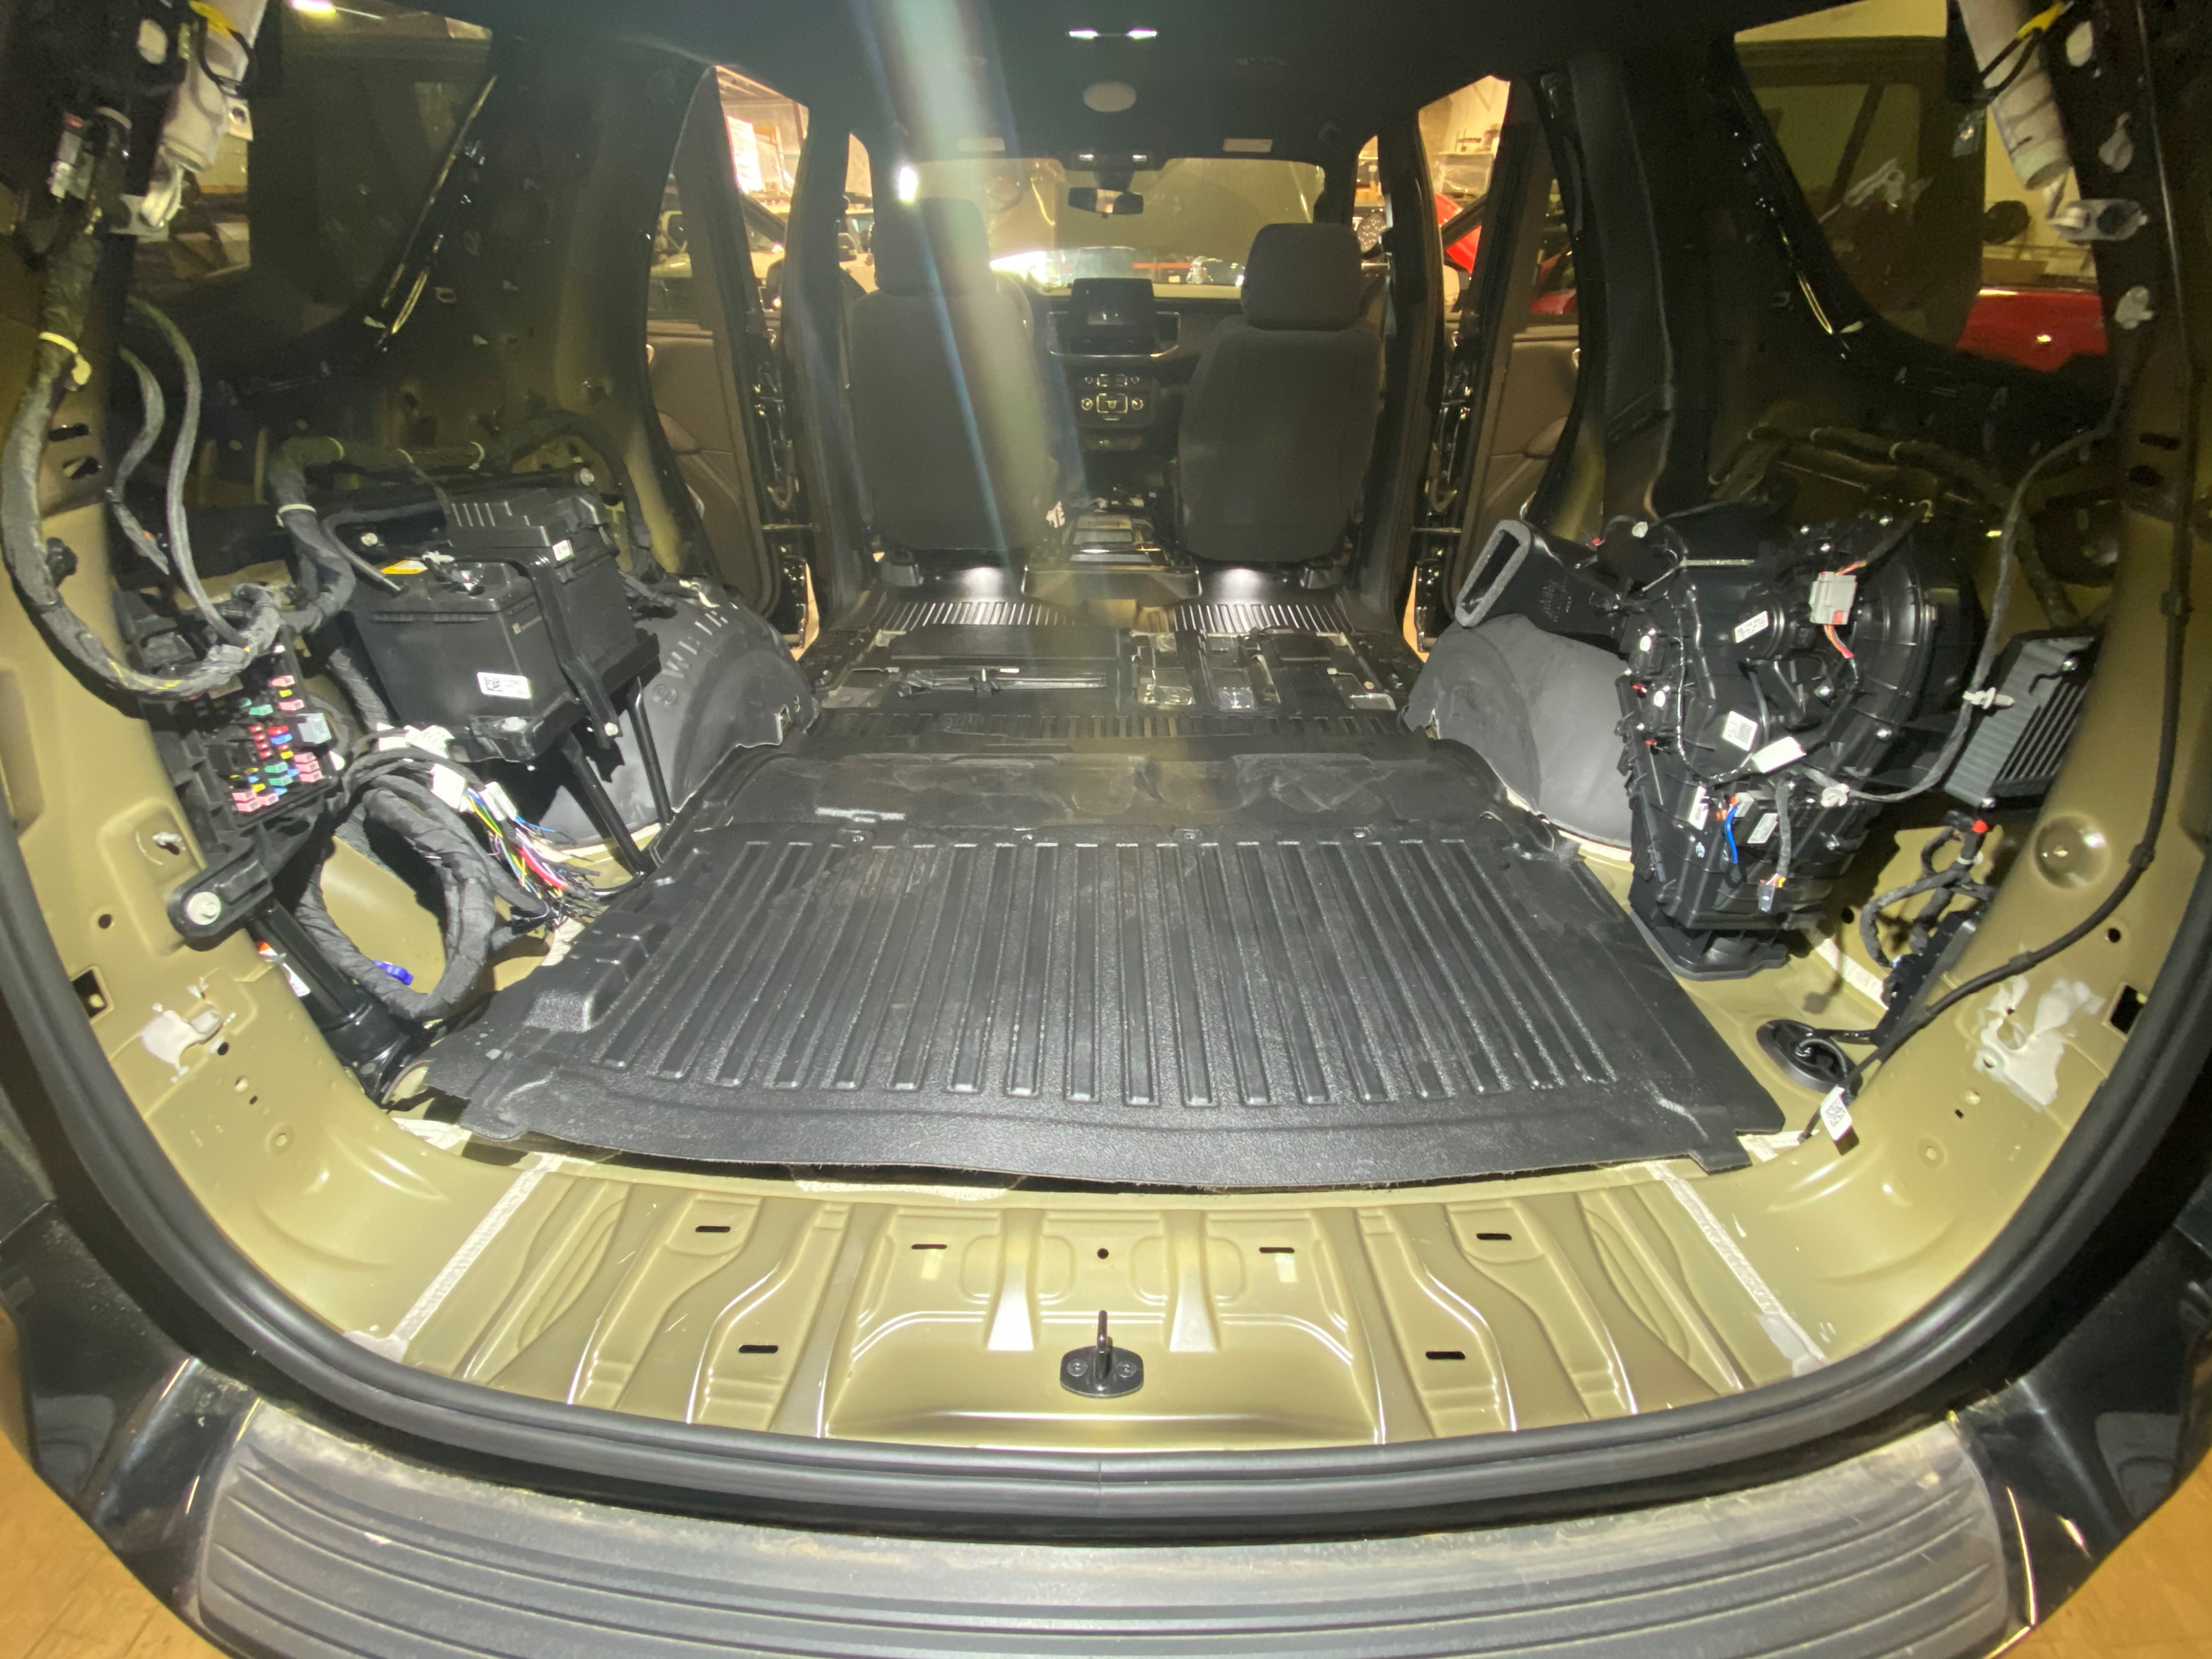
REMOVE REAR FLOOR MAT
REMOVE C & D PILLAR TRIM FROM VEHICLE
REMOVE REAR CARGO TRIM FROM VEHICLE
UTILITZE THIS TIME TO RUN ANY LIGHTING / CABLES, AS ONCE THE FLOOR IS IN THE TRIM WILL NO LONGER BE REMOVABLE WITHOUT REMOVAL.

Slide 4
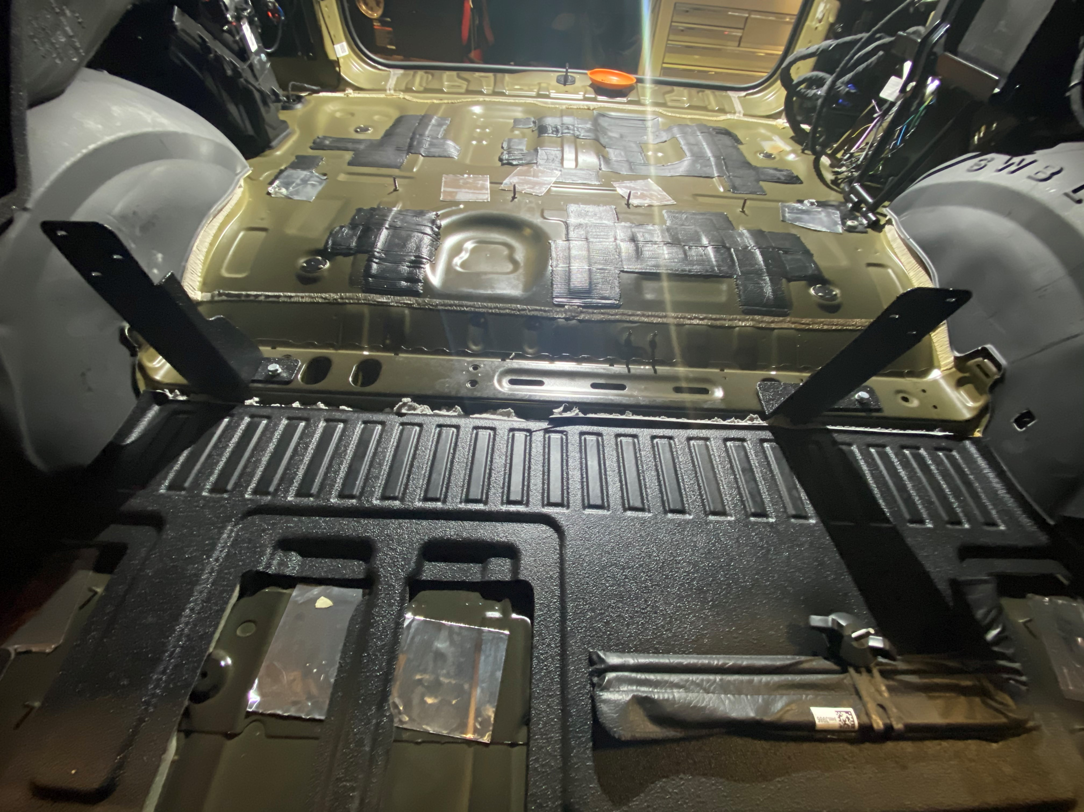
SHORT FOOT
LONG FOOT
USE A UTILITY KNIFE TO CUT ALONG THE FLOOR MAT ON THE 3RD ROW SEAT RAIL. REMOVE TRIMMED PIECE.
USING HARDWARE PROVIDED, INSTALL TWO FRONT MOUNTING FEET TO VEHICLE.

Slide 5
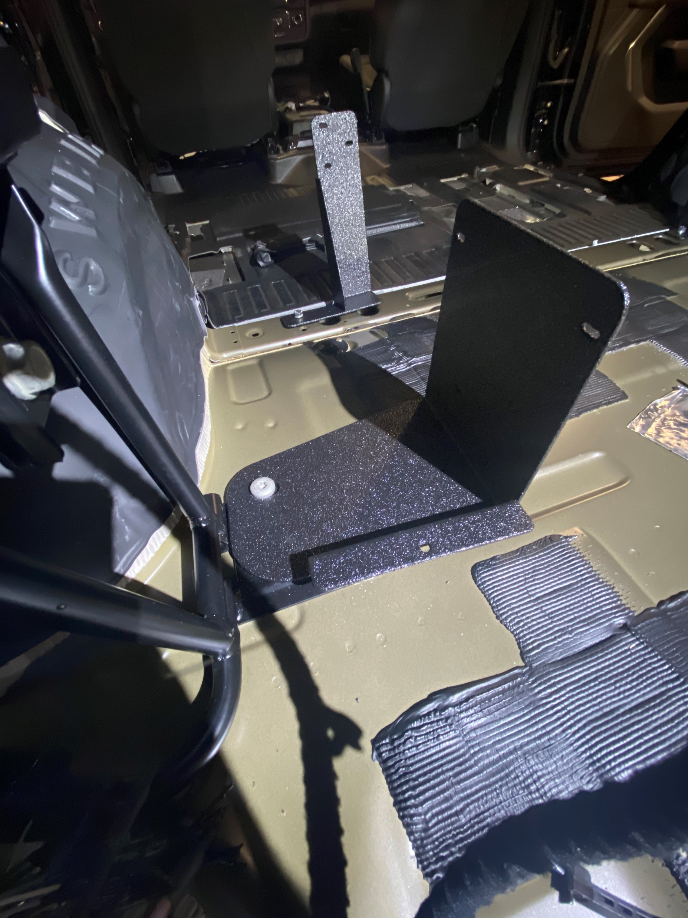
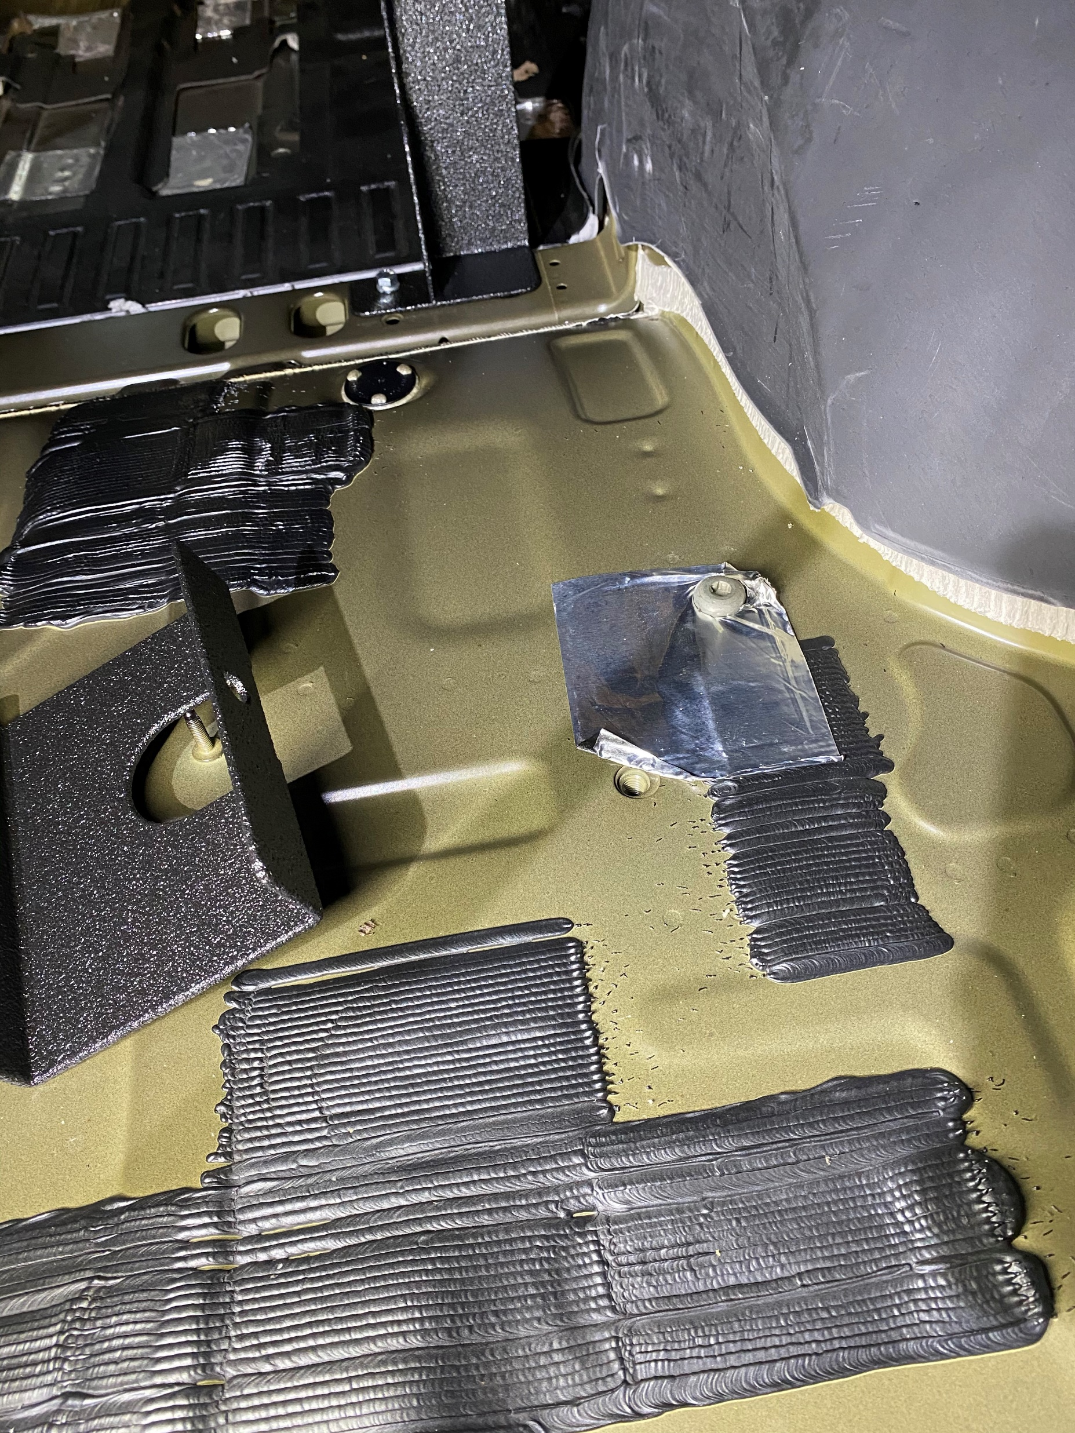
REMOVE FACTORY BOLTS FROM THESE TWO LOCATIONS
REMOVE FACTORY BOLT FROM THIS LOCATION
USE FACTORY HARDWARE TO INSTALL DRIVERS SIDE REAR FOOT

Slide 6
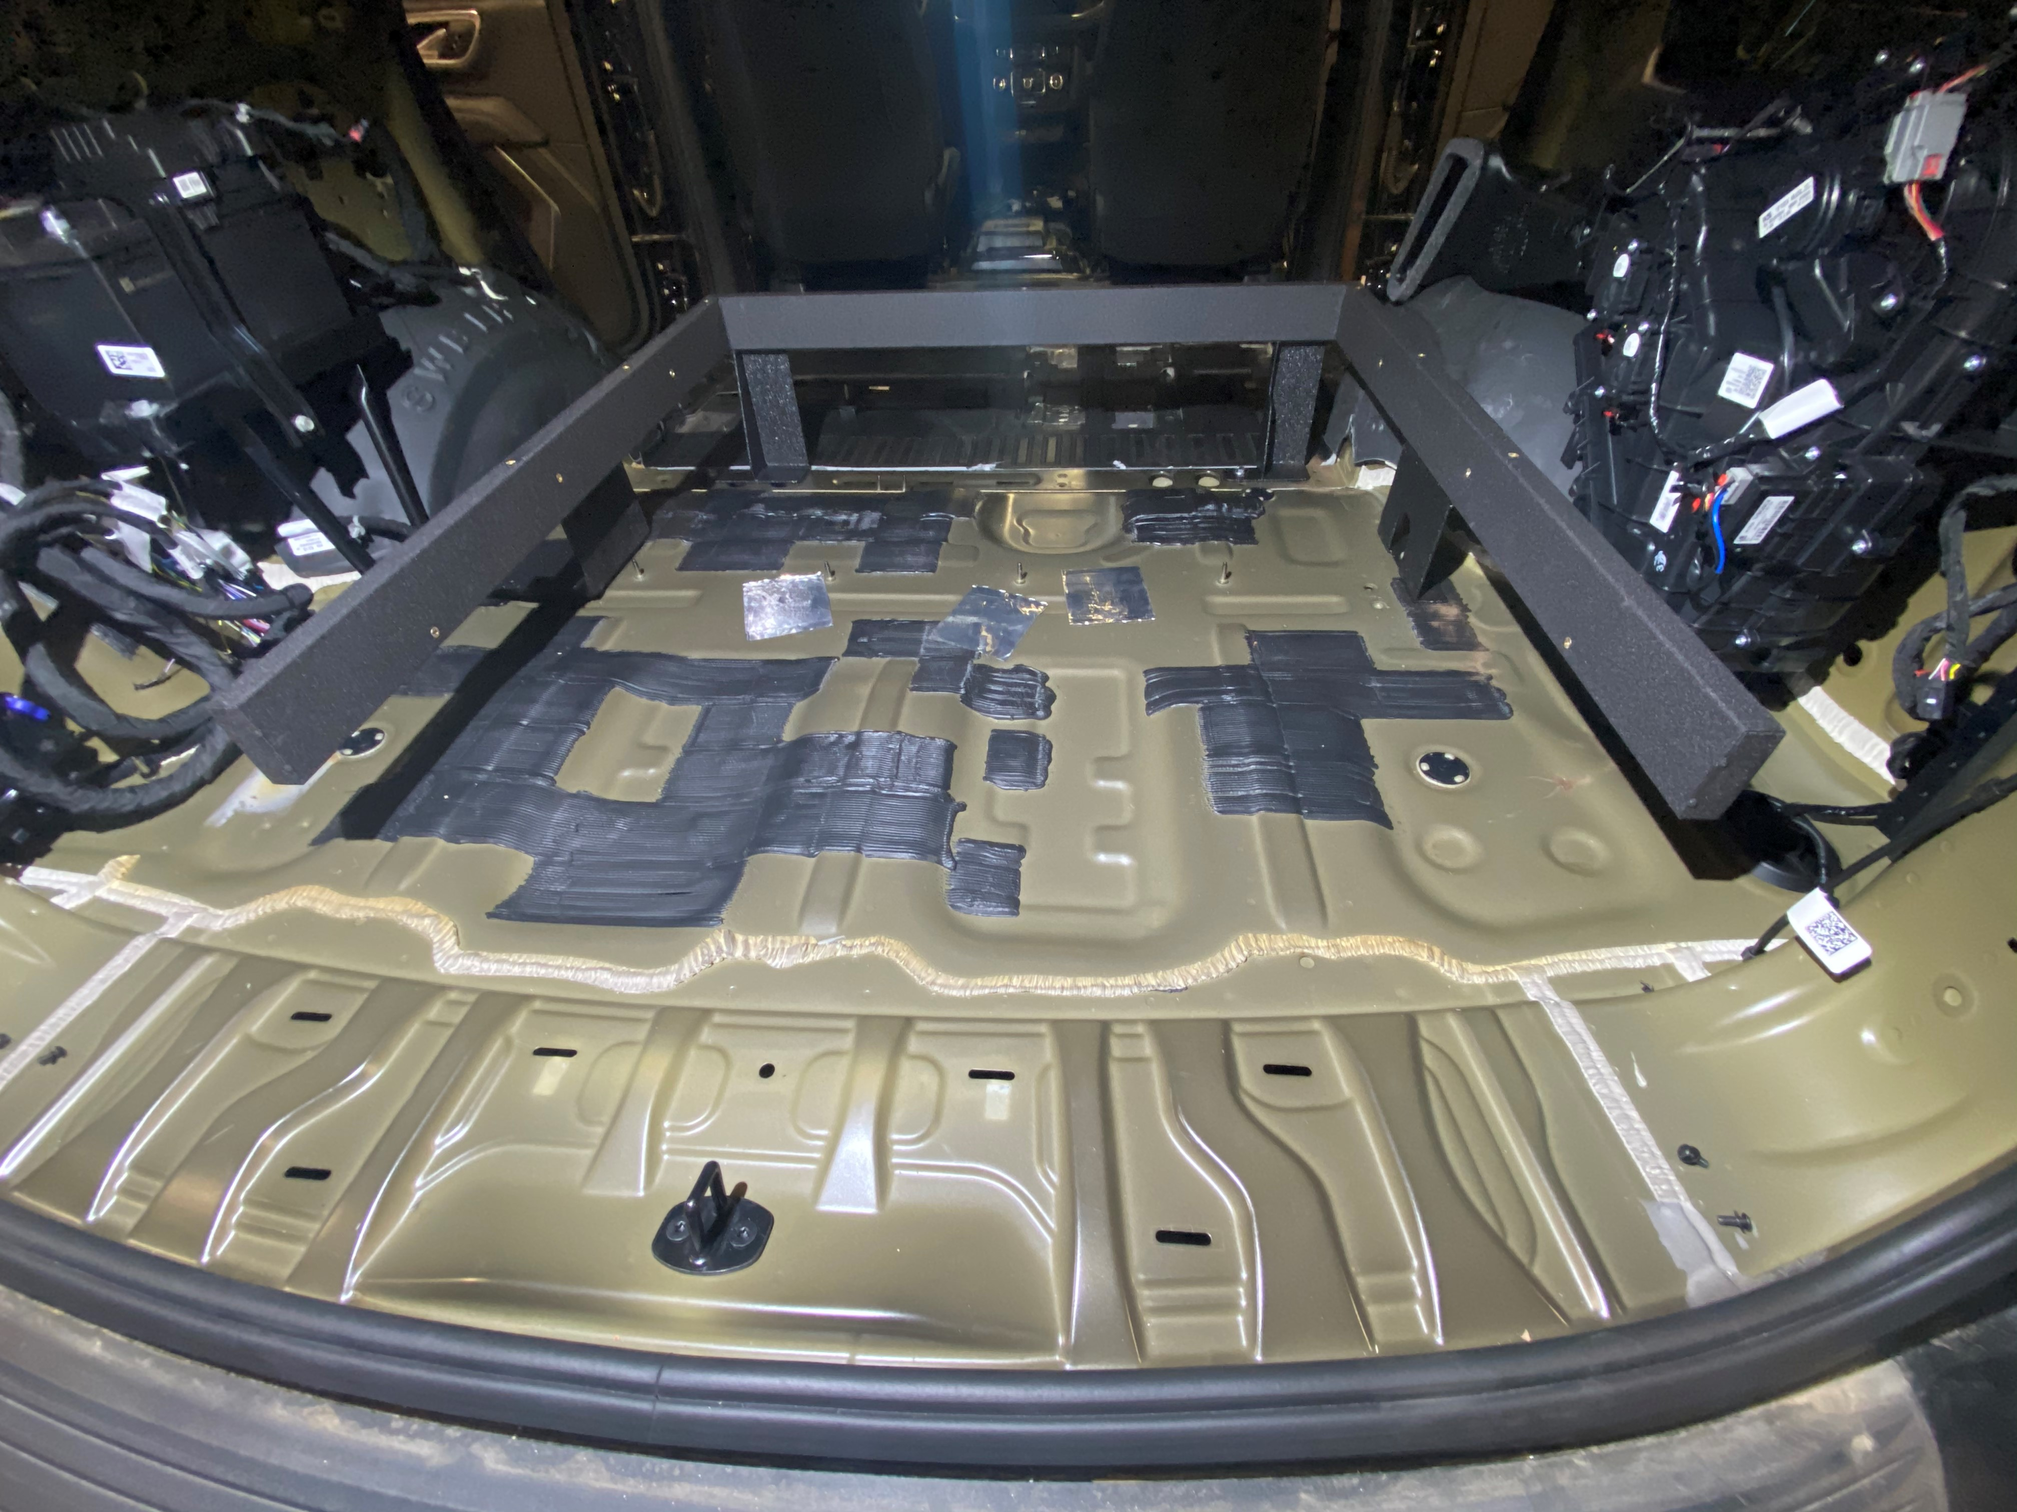
INSTALL PASSENGER REAR FOOT USING REMOVED FACTORY BOLT
PLACE FRAME INTO VEHICLE

Slide 7
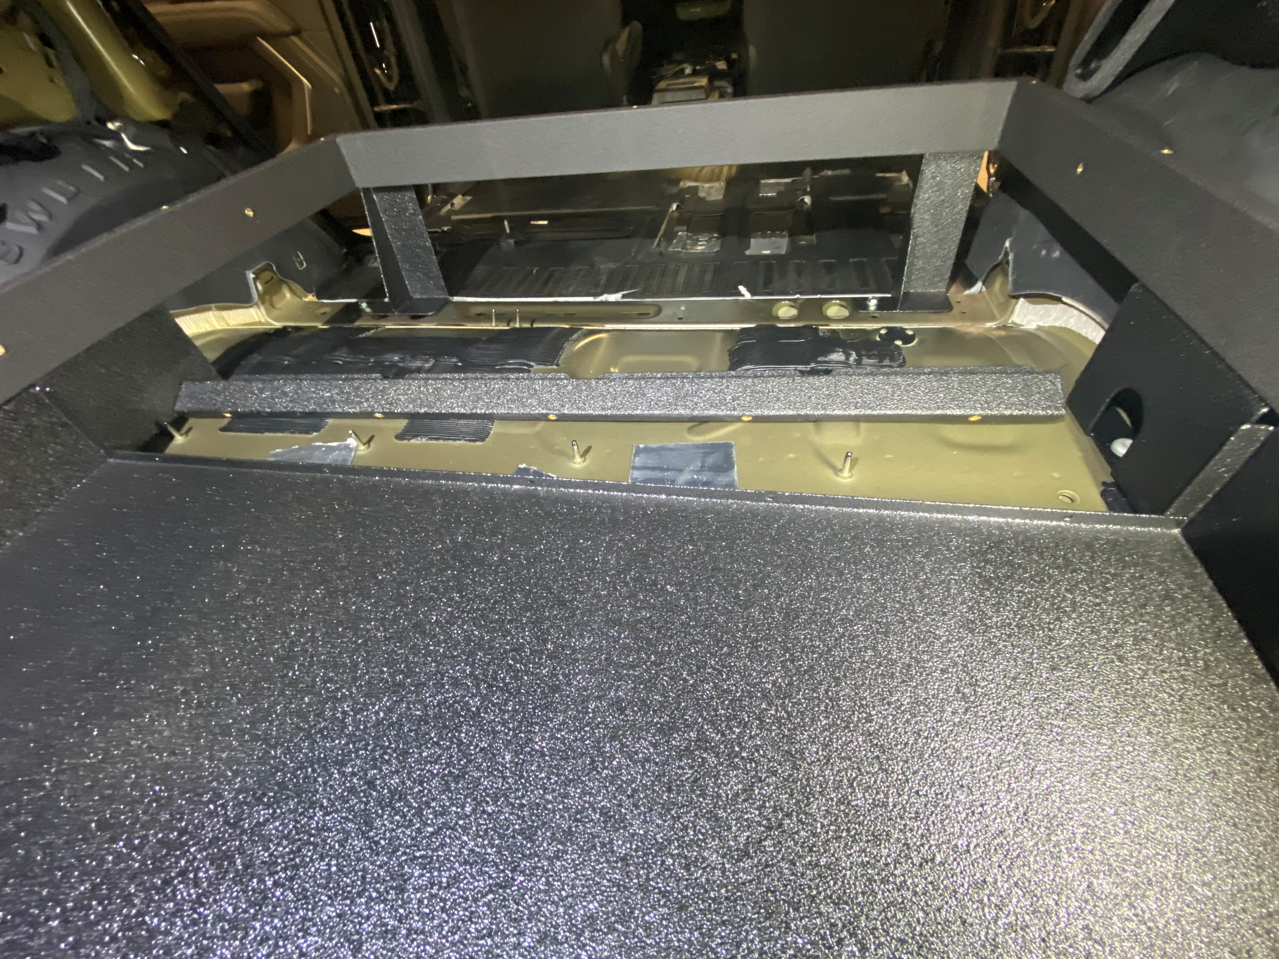
INSTALL SUPPORT BAR TO BACK OF PACKAGE TRAY
INSERT PACKAGE TRAY UNDERNEATH FRAME

Slide 8
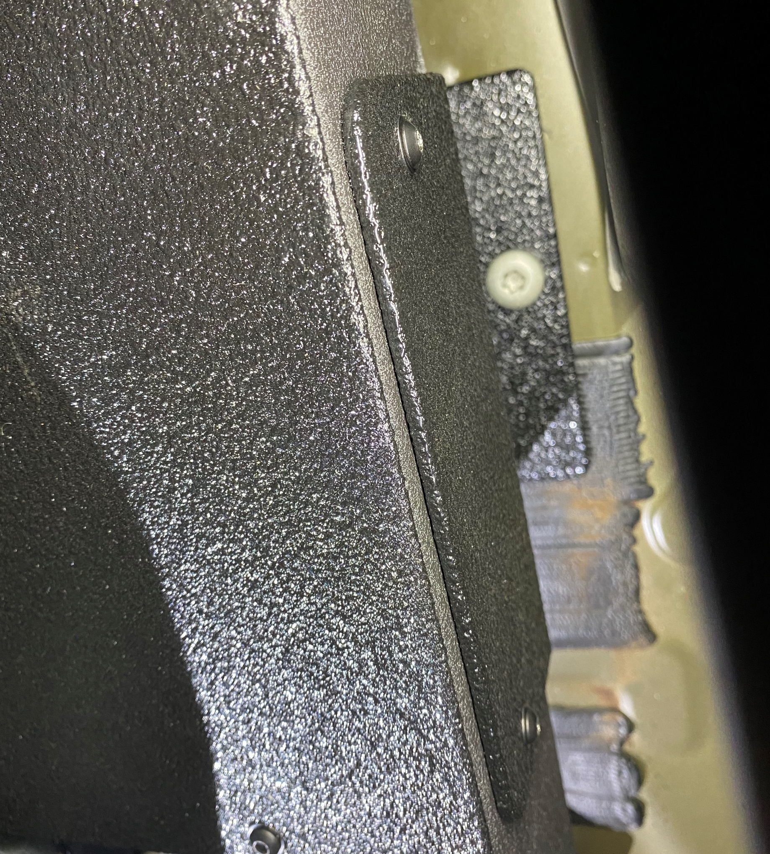
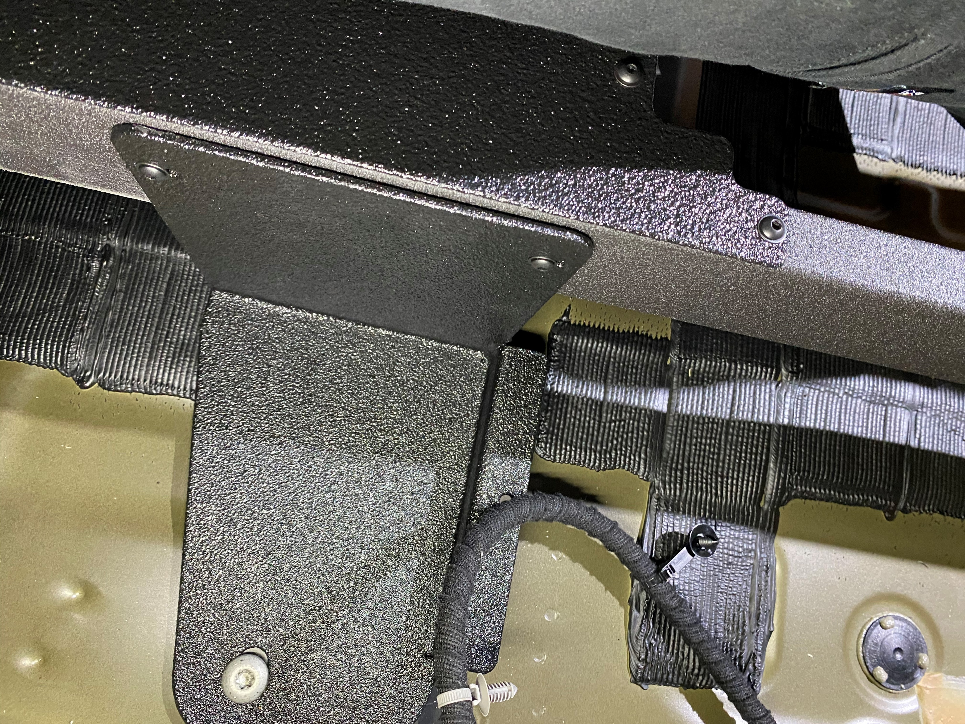
INSTALL SUPPLIED 10-32 BHCS INTO ALL MOUNTING BRACKETS ON FRAME

Slide 9
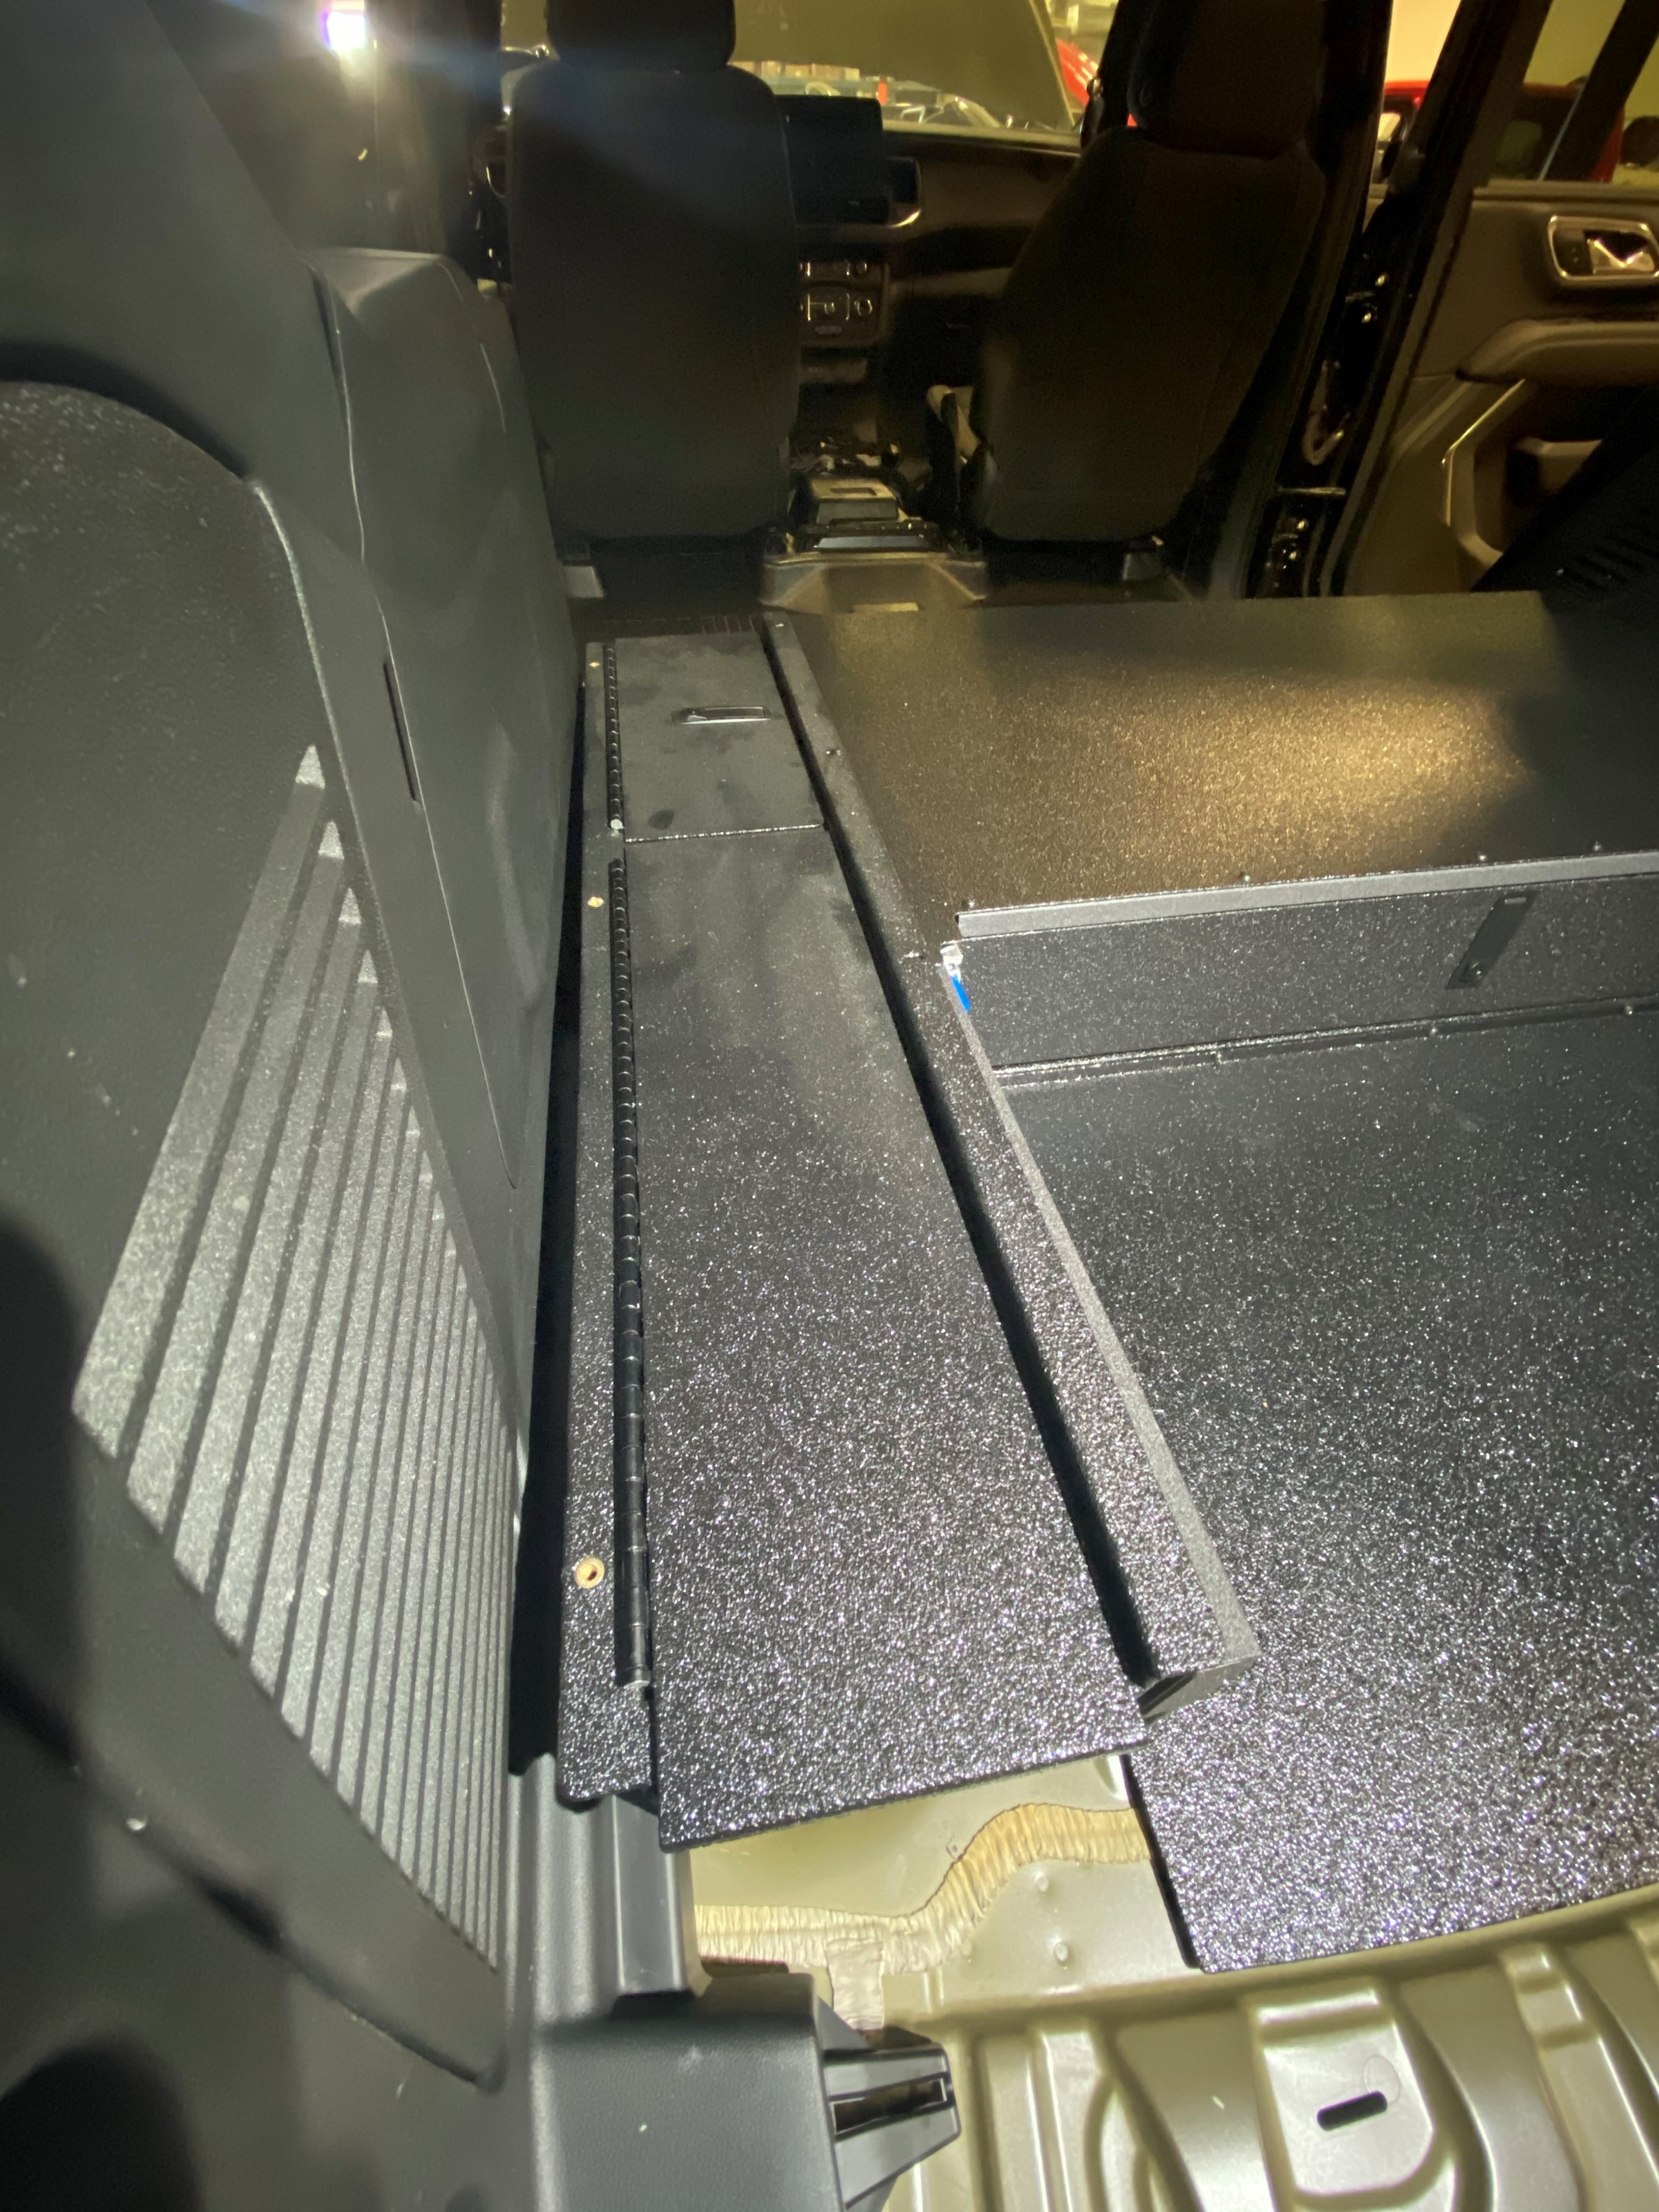
RE-INSTALL ELECTRONICS DRAWER
INSTALL SIDE BOXES, THEN INSTALL LID ONTO UNIT
** SIDE BOX FLANGE WILL GO UNDERNEATH THE LID**

Slide 10
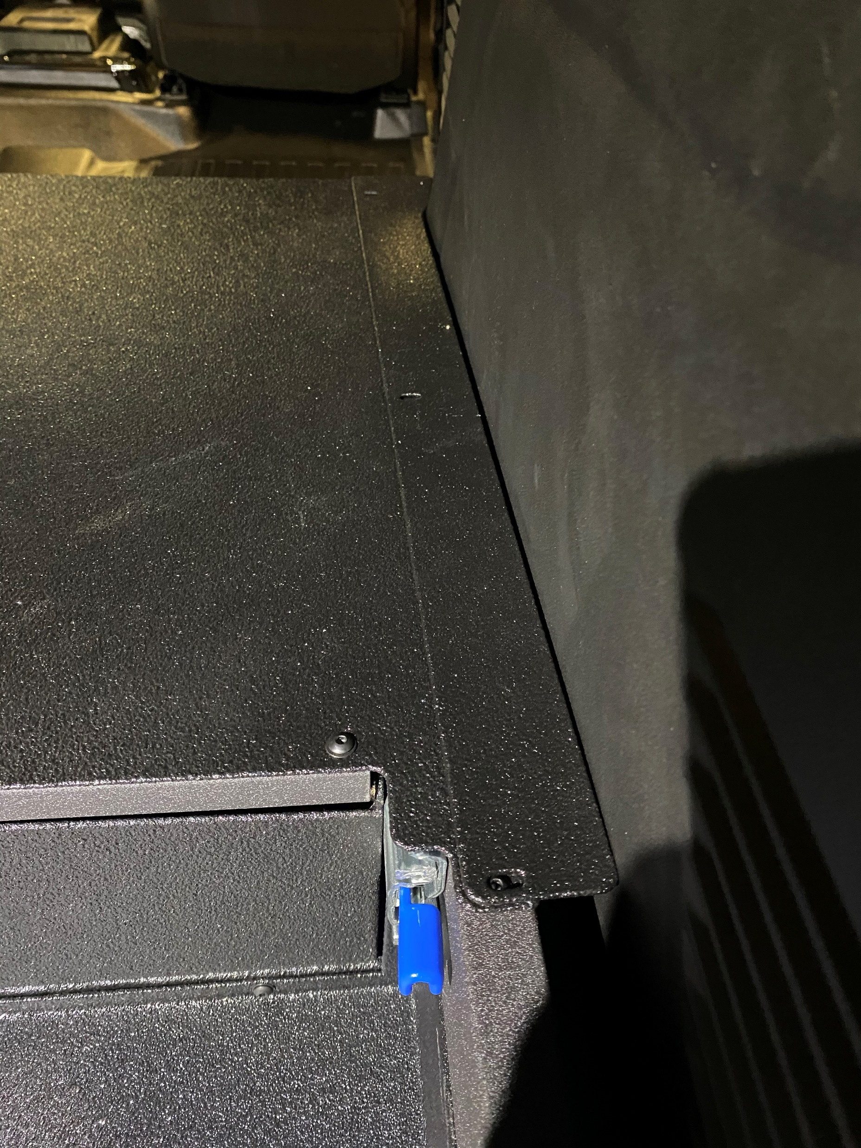
INSTALL FILLER PANEL ONTO FRONT OF THE SIDE BOXES
INSTALL SIDE FILLER PANEL ONTOP OF LID PANEL ON PASSENGER SIDE

Slide 11
INSTALL THE TWO FLAT HEAD SCREWS INTO THESE EARS INTO THE FRAME

